Slide 1
REVIEW 1 · BCSE307P
Automated Mutation-Based Compiler Code Optimization
Compiler Design Lab Project
School of Computer Science and Engineering (SCOPE), VIT · October 2026
[24BCI0183 – Mridul Kishanpuria] · [24BCI0188 – Girraj Yadav]
Facutly: Prof. Mukhtar Ahmed Sofi · Slot: L11 + L12

Slide 2
WHY THIS PROJECT
01
02
03
Objectives and research gap
Parse
Mutate
Validate
Convert MiniArith into naive TAC.
Apply classic optimizations one site at a time.
Match output and error status by differential testing.
04
05
06
Score
Search
Evaluate
Use a weighted simulated-cost model.
Greedily accept the lowest-cost valid program.
Run the pipeline on a reproducible seeded dataset.
Research gap
Existing tools are powerful yet difficult to inspect step by step. This project addresses a pedagogical gap: explicit mutations, candidate logs, validation results, costs, and observable search decisions, without claiming algorithmic novelty.
Make optimization inspectable from source program to accepted mutation.
2 / 10

Slide 3
LITERATURE REVIEW
Literature review: established foundations, transparent reimplementation
Aho et al.
Massalin · Schkufza et al.
TAC and classical compiler optimization foundations.
Superoptimization and mutate–test–score search.
The contribution is an educational reimplementation, not a new optimization technique.
Petke et al. · Kulkarni et al.
Tate et al.
Genetic improvement, phase ordering, and local search.
Equality saturation as a non-greedy alternative.
Lopes et al. · Yang et al.
Cummins et al.
Translation validation and compiler bug finding.
CompilerGym as an optimization research environment.
3 / 10

Slide 4
PROPOSED METHODOLOGY
Search, validation, and cost form one decision loop
Source → Lexer / Parser → Naive TAC → Mutation → Candidate Pool → Correctness Validation → Cost Evaluation → Greedy Selection → Optimized TAC
MUTATIONS
GUARDRAILS
COST
M1 zero-add removal · M2 one-multiply removal · M3 constant folding · M4 strength reduction · M5 dead assignment removal · M6 CSE · M7 constant propagation · M8 instruction reordering · M9 copy propagation.
Candidates must match original output and error status on deterministic inputs. Stop at a local optimum or the configured iteration cap.
0.4 instructions + 0.3 arithmetic operations + 0.2 temporaries + 0.1 simulated cycles. All components are normalized.
4 / 10

Slide 5
DATASET · CONTROLLED INPUT
Dataset & preprocessing are reproducible
15
6
62
seeded synthetic benchmark programs, P01–P15
categories: arithmetic, constant-heavy, dead-code, common-subexpression, strength-reduction, and mixed
dataset test cases, with 3–5 per program
Current dataset
Future expansion
Programs are generated from category templates; regeneration is byte-identical. Expected outputs come from an independent reference AST interpreter.
cBench, MiBench, PolyBench, and CompilerGym are future expansion sources, not part of the current dataset.
5 / 10

Slide 6
SYSTEM ARCHITECTURE
System architecture: modular components, one observable workflow
Architecture
Workflow
Frontend: lexer → recursive-descent parser → naive TAC generator.
Optimizer loop: Mutation Engine → deduplicated Candidate Pool → Correctness Validator → Cost Evaluator → Greedy Selection.
Execution support: TAC interpreter, reference interpreter, test-input vectors, and simulated cycles.
Output: optimized TAC, result files, plots, and final reference checks.
Parse and generate baseline TAC.
Generate inputs and record baseline outputs and cost.
Apply operators at every site and deduplicate.
Reject incorrect candidates, score valid candidates, and accept the cheapest improvement.
Repeat, then run final checks.
6 / 10

Slide 7
IMPLEMENTATION
Correctness and cost stay inspectable
Core stack
Mutation operator matrix
Python 3 standard library · matplotlib · Mermaid · unittest · custom random-program fuzzer
ID | Operator | ID | Operator | ID | Operator
M1 | Zero-add removal | M2 | One-multiply removal | M3 | Constant folding
M4 | Strength reduction | M5 | Dead assignment removal | M6 | Common subexpression elimination
M7 | Constant propagation | M8 | Instruction reordering | M9 | Copy propagation
Observable outputs
Every candidate → candidate_log.csv
Results → results.csv and summary.json
Soundness fix. Fuzzing exposed a division-by-zero bug. Unsafe deletion or movement of possibly trapping divisions is now blocked.
Simulated cycles: +, −, <<, copy, and I/O = 1; * = 3; / and % = 10; plus a read-after-write stall.
7 / 10

Slide 8
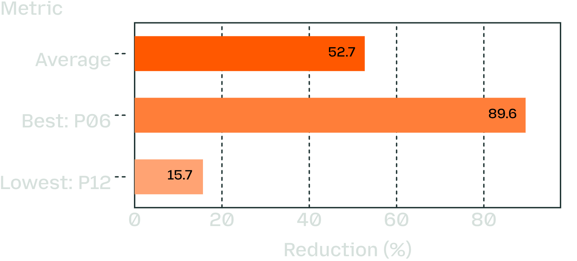
RESULTS · EMPIRICAL EVIDENCE
Strong correctness with measurable gains
52.71%
Reported cost-reduction summary
average cost reduction
3,343
candidates evaluated; 3,343/3,343 validation tests passed
4,500/4,500
Best reduction on P06: 89.56%; lowest reduction on P12: 15.65%. Average accepted mutations / iterations per program: 19.33, range 11–28.
unseen inputs matched the reference interpreter
1,300
Dead-code and constant-heavy programs improve most; strength reduction improves least because it mainly lowers the cycle component. Correctness is empirically tested, not formally proven; execution time is simulated.
random programs produced 0 incorrect results after the soundness fix
8 / 10
Notes:
The reported reductions use a simulated cost model, not measured execution time.

Slide 9
COMPLETE
Core prototype
Frontend, TAC generator, interpreter, 9 mutation operators, validator, reference interpreter, cost model, greedy search, seeded dataset, results, plots, tests, and fuzzing.
PROJECT STATUS
IN PROGRESS
Core prototype complete, scale-up next
Scale-up design
Design of the scaled dataset and tiered expansion plan.
NEXT
Broader search and semantics
The end-to-end Review-1 pipeline is working; the next question is how far it scales.
Scale to 200–500 programs; explore simulated annealing or beam search; add SMT-based equivalence checking; support control flow and 32-bit overflow modeling.
9 / 10

Slide 10
TAKEAWAY
REFERENCES
Conclusion and references
Aho et al. TAC and classical compiler optimization foundations.
Massalin; Schkufza et al. Superoptimization and mutate–test–score search.
The Review-1 prototype demonstrates an end-to-end mutation-based TAC optimizer with differential-testing validation and cost-guided greedy search.
Petke et al.; Kulkarni et al. Genetic improvement, phase ordering, and local search.
Tate et al. Equality saturation.
15 seeded programs achieved 52.71% average cost reduction with all reported correctness checks passing.
Lopes et al.; Yang et al. Translation validation and compiler bug finding.
Limitations: synthetic dataset, simulated execution time, empirical rather than formal correctness, straight-line integer code, and greedy local optima.
Next: larger datasets, stronger search, and formal equivalence checking.
Cummins et al. CompilerGym research environment.
Full bibliographic details and URLs should follow the course citation style.
10 / 10

